Slide 1


The Basics of R Day 1 – Basic Functions
AFS Alaska Workshop
An Introduction to the R Programming Language for Fishery Biologists
February 2022
Instructor: Justin Priest
https://github.com/justinpriest/R_Intro_AFS

Slide 2
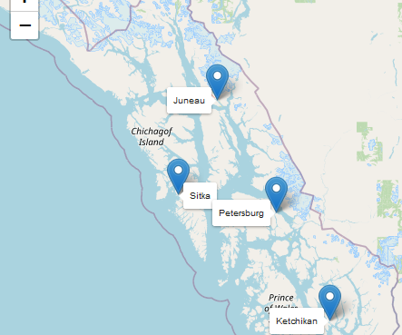
Introductions
library(leaflet)
df <- data.frame(cities = c("Juneau", "Sitka", "Petersburg", "Ketchikan"),
lat = c(58.2758, 57.0529, 56.8122, 55.349),
lng = c(-134.3913, -135.3324, -132.9554, -131.670))
leaflet(df) %>%
addTiles() %>% # Add default OpenStreetMap map tiles
addMarkers(popup = ~cities,
label = ~cities,
labelOptions = labelOptions(noHide = T))
Today we have 12 participants!
Briefly introduce yourself, including
What types of assessments & figures you do for work
Your R experience / familiarity
Why you would like to learn R
When done, pick the next person
Notes:
Have each person introduce themself

Slide 3


Welcome
What you’ll need today:
Computer with R & RStudio installed
Files that Justin emailed over
If there is something that is wrong (e.g., broken link) or could be explained better, please let me know and/or write it down.
After the course, there will be a survey to give me feedback on improvements

Slide 4


About Your Instructor
Justin Priest
2020 UAF CFOS Graduate
Learned R tools at CFOS (easy way) &
taught myself (hard but fun way)
ADF&G Coho Salmon Researcher in Sitka & Juneau

Slide 5

Today’s Agenda
09:30–10:45 1 – About R
10:45–12:00 2 – Basics of Programming
12:00–13:30 Lunch Break
13:30–15:00 3 – Working with your data
15:00–16:30 4 – Basic Data Manipulation
16:30–17:00 Review of Material
Each section will be organized by:
~20–30 min PowerPoint
~20–30 min RStudio demo
~10–20 min “learnr” code practice
Most learnr tutorials will not be able to be completed on time; that’s ok! Finish later
Notes:
In the first section we’ll go over what R is, the basic overview of the “grammar” used, and some simple commands. For this first section, it will mostly be powerpoint based so follow along with the slideshow.
In sections 2 through 4 we’ll cover more about how to understand what R is and how to get it to do what you want. These are broken into individual script files for each section so that you may follow along. We’ll build a little bit more on the foundations previously learned with each section.

Slide 6
Tomorrow
Project!
Throughout today, think of the project that you’ll work on tomorrow, especially whether any issues we’ll discuss pertain to your dataset.
09:00–09:30 Welcome and Review
09:30–11:30 5 – Charts
11:30–12:00 6 – Basics Analysis
12:00–13:30 Lunch
13:30–14:00 8 – Tidyverse
14:00–16:30 Project
16:30–17:00 Review of Projects
Today will unfortunately be a little dry but tomorrow will be very visual!
Notes:
Just so we have a little bit of a roadmap, here’s tomorrow’s schedule
Don’t stress too much about your final project. You won’t have to present it and nothing needs to be shared

Slide 7
Expectations
This will be an intensive but rewarding course
As such, it requires your complete attention
Close out of your email. Please be fully present

Slide 8
Course Outcomes
By the end of this class, you will be familiar with the basics of R
Hopefully, you’ll be familiar enough to read it, and use these slides for future reference
Don’t get bogged down in the details or try to memorize everything, this is a language after all.
We will go through code together, then you can run through it on your own later
Ask questions in the chat or raise hand
Answer each others' questions or “like” questions that are tricky
The More You Know
Notes:
Because of this, the slides are intentionally a little bit wordy. I apologize for that as it makes the aesthetics worse but I want this document to serve a little bit as a reference guide for you.
Today might be slow but we’re laying the foundation for charts & modeling
Not everyone needs to be an expert, but if you’re here, I want you to move up a level and at least be able to “read” R

Slide 9
Learning Philosophy
This is a “failure positive” zone!
You can’t break anything. Be creative, think like a kid, see what happens when you type things.
Ask questions! No dumb questions when you’re learning a language
Every mistake is a lesson: Ask me or yourself why something didn’t work
Communicate when I’m going too fast
One remote teaching request: if possible, keep video on so I can see your faces
Notes:
Sometimes you should pay close attention to the slides, sometimes you should be practicing in RStudio; I’ll let you know
Teaching philosophy thanks to:
http://teachtogether.tech/en/index.html
https://journals.plos.org/ploscompbiol/article?id=10.1371/journal.pcbi.1006023

Slide 10
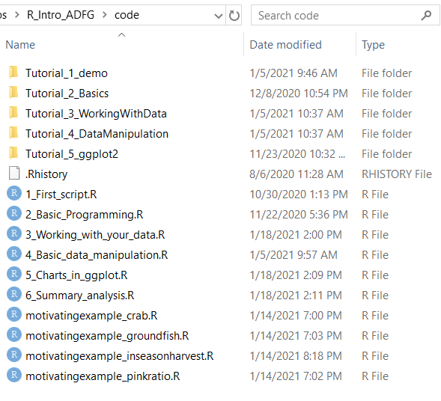
Guide
In the “code” folder, you’ll find:
Folders/files that start with “Tutorial” which review topics just learned with small & quick coding exercises
Files that start with numbers (e.g., 1_First_script.R) will be walked through together.
Files that start with “motivatingexample” are advanced scripts intended to show the usefulness of R. Don’t get bogged down in the details!
Notes:
Show folder in Windows Explorer
There are several types of scripts that we’ll work through in RStudio

Slide 11
How to Be Successful
This course is tough but if you do the following, you WILL learn R
Work on your OWN R project!
Email Justin
Review / complete assignments
Today Tomorrow night Next week Next Month 6 Months
Turn off distractions
Ask questions
Go slow
Review presentation Practice coding
Re-visit this presentation

Slide 12
1 – About R
Hello, my name is _R_
Notes:
R is both a software and a language
It is statistical in nature, and does NOT substitute for stat knowledge
As a language, R takes data and produces output: statistical test summary, graphical output (e.g., figures), lists of results, etc.
It is command-line based so all steps you take in analysis are documented

Slide 13
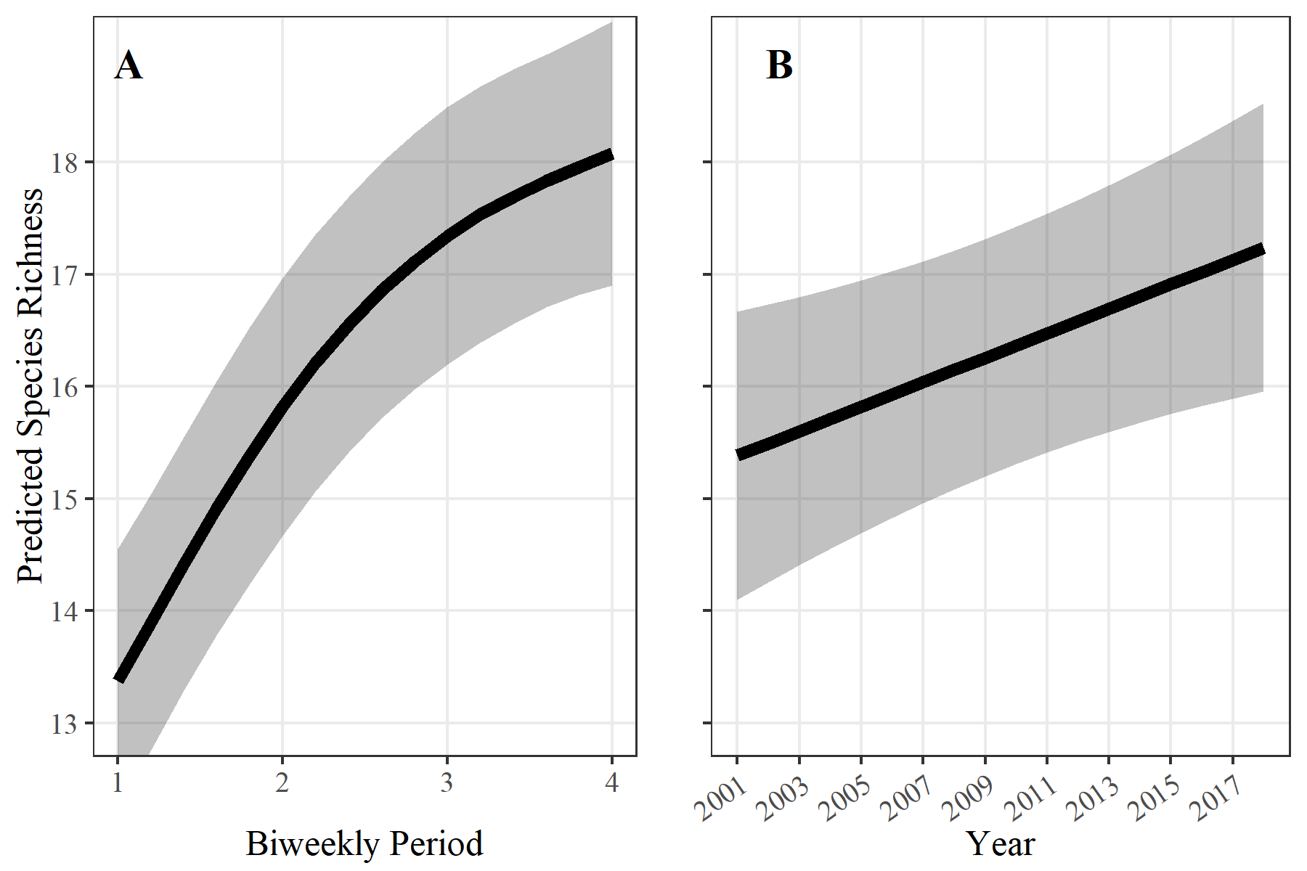
Why Use R?
Create publication quality figures!
Allows for reproducible research
“Saves” all your steps in a file
Easily automate steps you often do
E.g., data import from database
QA/QC’ing of data
High-powered statistical modeling is quite straightforward
Notes:
The first reason to use R is its power & capabilities.
Can do the data cleanup & charting of Excel, the statistics of SAS or MATLAB, simple app creation like Java or Python, and GIS capabilities of ArcGIS.
“If you can do the modeling in another program, you can do it in R”

Slide 14
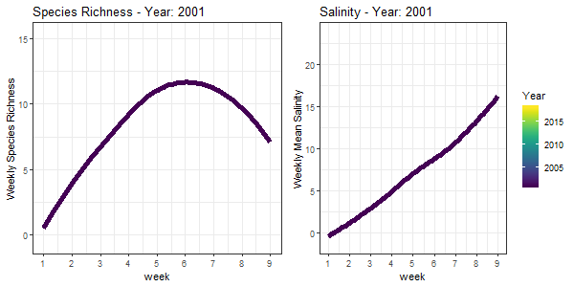
Why Use R?
Notes:
You can use R to create animations, interactive files, automated reports, whatever you want

Slide 15


Why Use R?
Relatively simple to learn
Constant advances & evolving features due to:
Open-source
Modular design
Active community
Online community is very friendly, helpful, and diverse!
Notes:
The other reason to use R compared to other programs are the human components.
R is easier to learn than most other languages. Today, to the extent possible I’ll try not to cover programming concepts. Other languages would require a much more thorough understanding of syntax and grammar while R will allow you somewhat intuitively read what you see.
In addition, the people that make up the R community are incredible
The open source nature has meant that the community keeps adding new features to R!
Community is very welcoming of new people, very diverse, supportive of its members

Slide 16


When to Use R
USE R
You need modeling or any other statistics done.
You will make a complex figure not possible in Excel.
You will be updating the figure many times in the future.
You will be working with biometricians.
DON’T USE R
You are making a figure that will never be updated.
You are doing extremely quick analysis.
Time is of the essence.
Notes:
While I’m a huge proponent of R, it is extremely important to realize that R is not the right tool for every job unless you are very proficient.
In general, there will be a huge upfront cost to R. If this is something repeatedly worked on by multiple people over a long time, that makes the upfront cost worth it.
Do not be afraid or embarrassed about googling things. I have been writing R for 4 years and google extremely simple details all the time.

Slide 17
R vs RStudio
What is the difference between R (AKA “R Project”) and RStudio?
RStudio requires R to run in the background
R is the engine, RStudio is the rest of the car
Think of R as notepad and RStudio as MS Word.
More powerful features and is much more user friendly
From now on, pretty much only open RStudio
Easiest to double click the .RProj file
Notes:
R is the language (and a very minimal program); RStudio is a full featured program. Think of Notepad vs MS Word.
RStudio is a popular program that runs on top of R
There are other “IDEs” to use but this is the best suited to R
It is HIGHLY recommended to just use this
I will not show or use the base program R today
Downsides: None until you’re a world-class expert
NOTE: If you don’t open RStudio thru clicking the .RProj file, you will have issues.

Slide 18
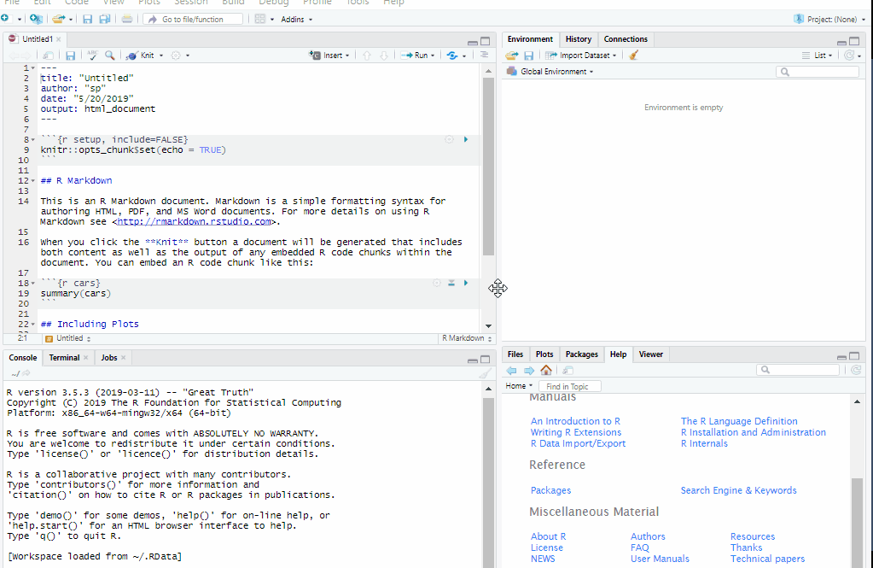
RStudio
You’ll see 4 panes. By default, they are:
Script editor in top left where you can write code before evaluating it,
Console in bottom left where code is evaluated and output is seen,
Environment in top right shows variables/dataframes (click on them to open and view!),
Plot/Help area in bottom right.
gif: https://www.pipinghotdata.com/posts/2020-09-07-introducing-the-rstudio-ide-and-r-markdown/

Slide 19
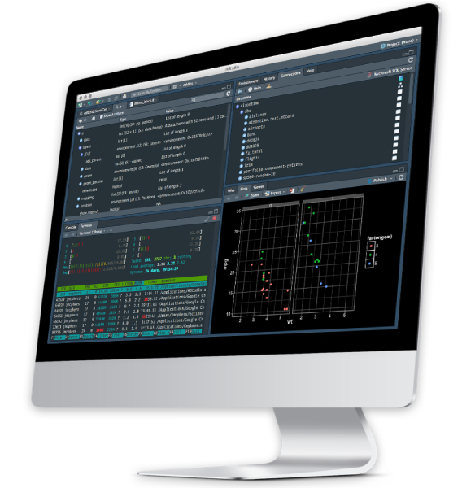
RStudio Demo
Let’s demo this in RStudio!
We’ll go over:
How to start / open RStudio
What each “pane” is
Where to type your code

Slide 20
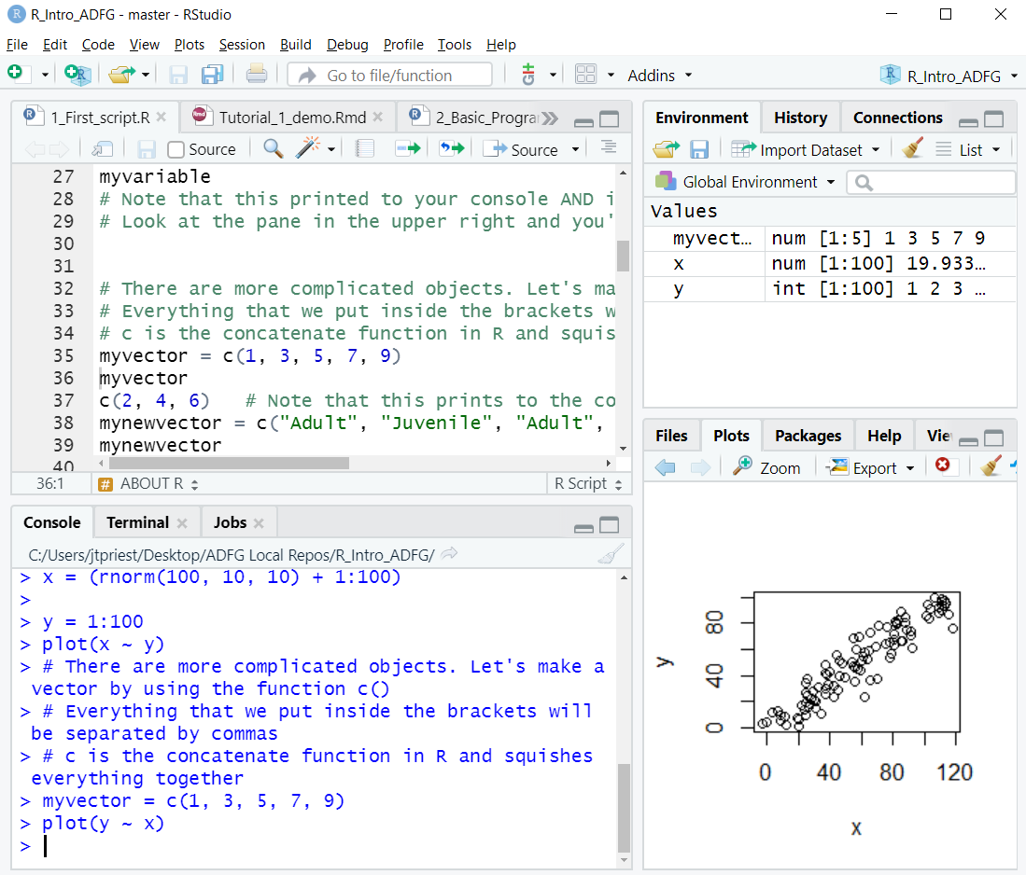
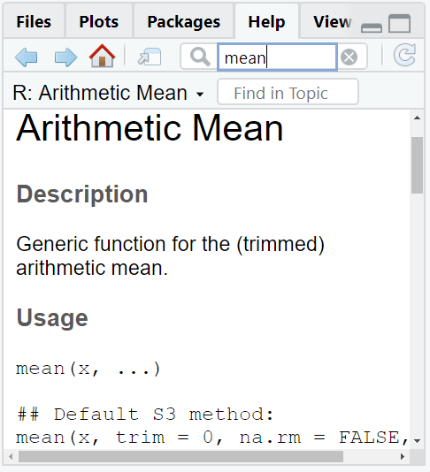
Script – A collection of lines of code saved to a file that can be run line by line, or all at once, usually the file extension is .R
If you want to save the code to use it again, you must save it in a script file
Script Editor
Environment
Environment – Shows all your variables. If it’s a dataframe, it’s clickable
Project – Shows which project you’re in. More on this later
Line – In script section each command has its own line. Lines must be complete bits of code otherwise they won’t evaluate (to wrap an incomplete chunk of code to the next line, it must end in a comma or something similar)
Plots / Help
Console
Plots – Shows your recent plots.
Help – Access the help file for every function
Console – The bottom part of the program where you can enter code to be run and where executed code is shown
20
Notes:
Perhaps the most useful feature of RStudio. Rprojects makes .rproj file; double click on this to re-open all the same scripts as last time AND set the directory to be the current folder

Slide 21
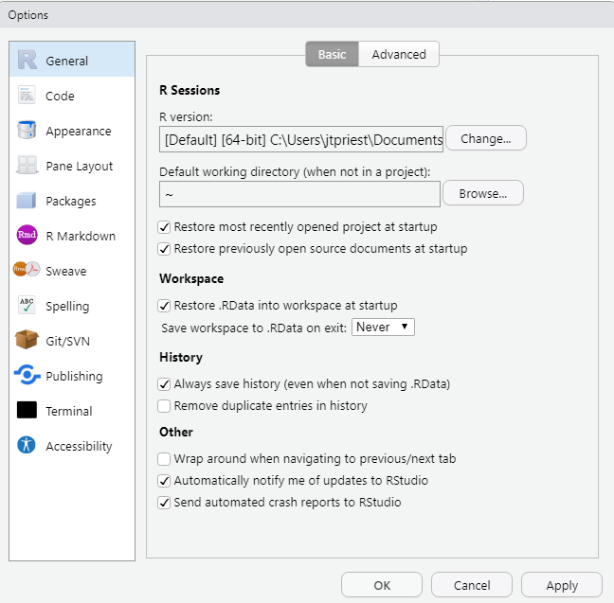
RStudio cont.
Highly recommended to change one default setting. Go to:
Settings
Click Tools -> General Options
This will bring up these options
Change “Save workspace to .RData on exit” to Never

Slide 22
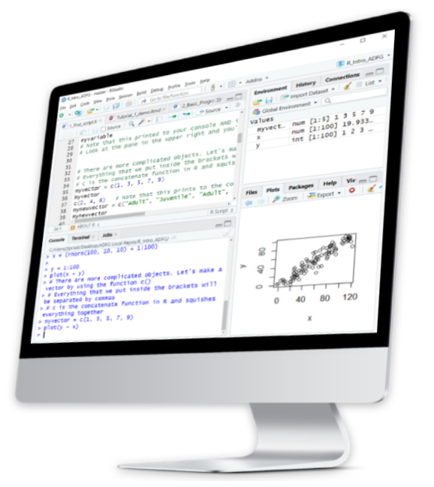
RStudio cont.
Back to RStudio!
Let’s make those changes
We’ll also go over:
What is an RProject?
How to open a script
Highlighting a word
Using the help tab

Slide 23
Versions
There are different “versions” of R, released to update software
Occasionally (~once a year) you may need to update R
Do this by downloading from CRAN and/or running:
install.packages("installr") library(installr) updateR()
Do you need to worry about R versions?
Do you perform biometrician-level analyses?
No
Yes
Don’t worry, be happy
Pay attention to versions
Notes:
Years ago, there were problems with versions being incompatible. These are largely addressed.
R Versions seem confusing but really are just the latest update of the software.
Some of you may have noticed warnings about versions during package installation
The exception is if you have “biometrician-level” software that integrates with R (e.g., JAGS or ADMB)

Slide 24
Quiz 1-1
When should you use “R Project” instead of RStudio?
Never. We always use RStudio.
Always. Kick it old school R
Always. I am a crusty old biometrician.
What are some advantages of using R projects?
Future advantages Justin hasn’t covered yet.
Opens most recent scripts
Sets folder directory automatically
QUIZ!

Slide 25

Quiz 1-1 ANSWERS
When should you use “R Project” instead of RStudio?
Never. We always use RStudio.
Always. Kick it old school R
Always. I am a crusty old biometrician.
What are some advantages of using R projects?
Future advantages Justin hasn’t covered yet.
Opens most recent scripts
Sets folder directory automatically
QUIZ!

Slide 26
Jargon
Function A set of commands that evaluates your data in a specific way. You can write your own function, or they can be provided via other packages
Argument In a function, this tells the function how to proceed For example: mean(data, na.rm = TRUE) uses an argument to remove NAs
Package A group of new commands / functions to extend the usability of your analysis.
Variable Something saved in R’s memory for use later.
Notes:
You’ve probably already used functions in Excel! These also had arguments

Slide 27
Jargon cont.
Dataframe A group of rows and columns (like a spreadsheet). Each column has a specific type (TRUE/FALSE, integer, number, character, factor, etc.).
Factor A type of variable that is a categorical grouping (“red” vs “blue”; “Treatment1” vs “Treatment2” vs “Treatment3”).
= The equals sign sets something to a variable (by convention, this is a static number, character, etc., not a dataframe)
<- The “leftward arrow” sets the items to the right to be equal to the variable on the left. For example: x1 <- NewVariable
c() Lowercase c means concatenate which groups a bunch of things together. For example: x1 <- c(“New Variable1”, “New Variable2”)
Notes:
We can use the rightward arrow too but this is less common

Slide 28
Even more Jargon
[] Square brackets mean selecting a subset
== To check if things are equal, use two equals signs together
!= To check if things are NOT equal, use this
(There are others that are used less commonly: & means AND, | means OR, ! means NOT, %in% means in a list)
~ In base R the tilde usually means “regressed upon”

Slide 29
The last of the Jargon
rm() Removes a variable from your workspace
str() Inspects the structure of a variable
$ Selects a particular column of a dataframe For example: dataframename$col1
# Makes a “comment” (not run code), telling R to not run anything on this line to the right
> print(“Hello!”) #This line only evaluates the Hello! part ignoring this
Also: Lines must end with a comma, bracket, or similar. If you want your code to continue to the next line, you will need a comma at the end of a line

Slide 30
Let’s head to RStudio
Let’s familiarize ourselves with RStudio
You are learning two things at once: the new-to-you program RStudio and the R language
We’ll put what we just learned to use in RStudio and review the basics of the program. You can watch my screen and/or run the lines yourselves. We’ll assess fisheries data that you use
Later, revisit the script on your own. Consider modifying lines
Read the comments then run the line (“Run” or Ctrl+Enter/Cmd+Return)
Go slow, it isn’t a race
Ask yourself why something works or fails

Slide 31
One last RStudio tip
If you’d like, you can change the appearance of RStudio (color & theme)
Go to Tools -> Global Options -> Appearance
Choose an “Editor Theme” that you like

Slide 32
RStudio Summary
What we just learned
How to open a R project
4 panes in RStudio
How to run a line
Difference between script & console
Autocomplete for functions
Highlighting a word
Help
Viewing a dataframe

Slide 33
Quiz 1-2
Which symbols would we use to “set something equal to” and “make a comment / don’t run line”?
== and comment()
<- and #
equal and c()
$$ and RUN
How can we tell R to run (evaluate) a line of code?
Ask nicely
Ctrl + Enter (Cmd + Return)
Swear
“Run” button
QUIZ!

Slide 34
Quiz 1-2 ANSWERS
Which symbols would we use to “set something equal to” and “make a comment / don’t run line”?
== and comment()
<- and #
equal and c()
$$ and RUN
How can we run (evaluate) a line of code?
Ask nicely
Ctrl + Enter (CMD + Return)
Swear
“Run” button
QUIZ!
Why?
Leftward arrow sets something while the hashtag means don’t run this line
Why?
There are two ways to run a line;
I usually use the keyboard shortcut

Slide 35
2 – The Basics of Programming
Did you know today was the day you became a programmer?

Slide 36
Errors
If you use R, you WILL get errors
You’ll get errors every other line (I do!) and that’s OK!
Don’t stress about an error, just find what the issue is
Errors don’t go away, you just get faster at solving them

Slide 37
Basic Programming
To set objects we use “=“ or “<-”.
(By convention, use equals for setting variables that don’t change (a=5) and the arrow for everything more complex)
You re-write over previous values every time you evaluate
R is case sensitive
Use ctrl+Enter (CMD+Return) or run button to evaluate
> a = 5
> a
[1] 5
> a = 7
> a
[1] 7
> A
Error: object 'A' not found
The [1] in the console output means it’s the 1st element

Slide 38
Basic Programming cont.
> x1 <- c(10, 8, 10, 12)
> mean(x1)
> x2 <- c(1, 2
log(), sqrt(), sum()
seq(from=0, to=100, by=2)
c() is short for concatenate, or combining things together
Lines can’t continue if left unfinished
Explore what happens when you take log of something
Create a sequence

Slide 39
Basic Programming cont.
Enter the following code:
x3 <- c(2,4,6,8,10)
x3[5]
This returns the 5th element (10)
myfirstdf <- data.frame(sex = c("Male", "Male", "Female"),
length = c(110, 112, 90),
weight = c(3, 3.4, 2.4),
age = c(2, 2, 1))
myfirstdf
Look at this dataframe! You’ve got some data!

Slide 40
Quiz 2-1
What would be the result after running these 3 lines:
myvalue = 5
myvalue = 7
myvalue
5 OR 7
BUG HUNTER: Which lines of code contain no problems?
mean(c(1, 2, 3, 3, 4)
Seq(from = 1, to = 5)
myvalue == 5
c(1, 1, 3, )
sum(1, 2, 3)
QUIZ!

Slide 41
Quiz 2-1 ANSWERS
What would be the result after running these 3 lines:
myvalue = 5
myvalue = 7
myvalue
5 OR 7
BUG HUNTER: Which line(s) of code contain no problems?
mean(c(1, 2, 3, 3, 4)
Seq(from = 1, to = 5)
myvalue == 5
c(1, 1, 3, )
sum(1, 2, 3)
QUIZ!

Slide 42


Quotations
Knowing what is and isn’t put in quotes is tricky when starting out
Single quotes ‘x’ are usually interchangeable with double quotes “x”
Often you differentiate between a character and a variable by putting characters in quotes
Conversely, sometimes you quote variables inside a function
Notes:
It might feel maddening at first, but its like learning any language.
There are rules and they’re consistent with themselves but it might take a little bit before the rules feel intuitive

Slide 43
NAs
If you import your own data, you’ll inevitably run into NA issues.
An NA is just a known “blank”
R will often throw errors for NAs
It just doesn’t want to assume it knows best what you want
You can usually remove NAs in a function (usually good idea) or filter them out ahead of time
> mean(c(3,4,5,6,NA))
[1] NA
> mean(c(3,4,5,6,NA), na.rm = TRUE)
[1] 4.5
Remember:
“A blank is not a zero!”

Slide 44
Operators
& means “and”
| means “or”
! means “not”
%in% checks if things are in a list
Helpful if you’re filtering to a subset of species!
X
Y
X | Y
X Y
X Y
X Y
X & !Y
!X & Y
X & Y
X Y
X Y
X Y
xor(x, y)
X Y
Notes:
Do not memorize this graphic. Instead remember it’s here and refer back to it!
xor() is covered here for completeness but to be honest I’ve never used it

Slide 45
A Word About Types
All variables (objects) have attributes and these attributes MUST be compatible within themselves
For example, if you have this list
But if you have this list
Use str(), typeof() to check the structure and type of objects
> c(1,2,3,4,5)
These are all numeric!
> c(1,2,3,4, "five")
Then these will ALL be characters
> str(c(1,2,3,4, "five"))
chr [1:5] "1" "2" "3" "4" "five"

Slide 46
Object Types
Vector
Matrix
Factor
List
Dataframe (made up of previous types!)
and others!
Dataframes are what you’ll use 90% of the time
> as.vector(c(3,4,5,6))
[1] 3 4 5 6
> as.factor(c("area1", "area2", "area3"))
[1] area1 area2 area3
Levels: area1 area2 area3

Slide 47
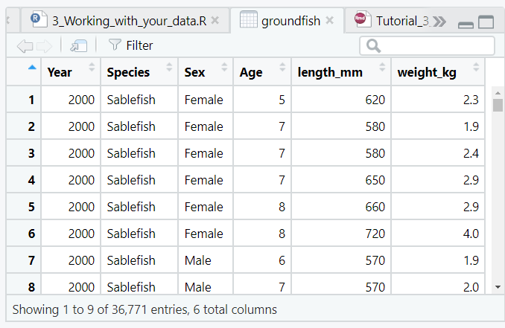
Dataframes
What is a dataframe?
Think of a dataframe as analogous to a spreadsheet. There are rows and columns
Each column has a specific “type”, and this type doesn’t change between rows
Can’t contain both characters and numbers
We can change it later if needed
Numeric (Integer)
Numeric
Numeric
Numeric
Character
Character
Notes:
Technically, there are multiple types of numeric variable. Integers are whole numbers while “double” are to the decimal place

Slide 48
Numeric vs Factor Variables
It is important to understand the difference between a variable that is a factor (categorical) and a number.
Sometimes these distinctions are tricky (e.g., District Number is technically a category)
Year can be a funny variable. Could be a factor (compare ANOVA between years) or numerical (time trend)
Factor | Numeric
Species | Measurements
River | Counts
Station | Duration
Year | Year
Why does this matter?
Variable type controls plot type (e.g., scatterplot is numerical vs numerical; boxplot is factor vs numerical) and statistical models
Notes:
A factor is something that is a category such as fish sex being male or female,
If you have modeling or plotting errors, this is something to check!

Slide 49
Variables
Good
juneaurain_2005-2019
blackcod_surveycount
tanner_chela
What is a variable?
Saves something by name to look at later
Variable Naming:
Never name something the same as a function (e.g., “mean”)
Can’t start with a number
Can’t contain a space, comma, etc.
Make it memorable & recognizable to others
Bad
x
1 dataframe
dataframe1
mean
weight
cs125_10_g
Notes:
Why would we want to set something as a variable?
Upper vs lowercase

Slide 50
Errors Revisited
Some common errors:
Misspelling variable/function
Not ending a line in parenthesis, comma, etc.
Unpaired parentheses/quotes
Capitalizing vs no caps
Not loading package before calling function
Wrong data type is used
RStudio will help minimize these!
Experience, going slow & thorough minimizes these!

Slide 51
Errors Revisted cont.
Error Message | Possible Problem
unexpected symbol in ____ | You made a syntax (coding grammar) error (extra comma, parenthesis, etc.)
could not find function | You forgot to load a package or misspelled the function name.
cannot open file .* : No such file or directory | You tried a path that doesn't exist.
there is no package called ___ | You forgot to install a package or misspelled the package name
object .* not found | The object you are looking for might not exist.
non-numeric argument to ___ | You tried to use a character vector where a numeric is needed.
attempt to apply non-function | You tried to use an object which is not a function as a function.
object of type 'closure' is not subsettable | You called `$` on a function.
More common
Less common
Based on https://github.com/colinfay/argh
Notes:
Don’t memorize this list! Instead use it as a reference to come back to.
These are somewhat organized from the error messages that you’ll see today to those that are a little more obscure

Slide 52

Stop! And Restarting
Practice closing out of RStudio and then reopening. You can click save workspace or not. See what happens when you do both!
Practice closing out of a long loop (stop button) and open-ended code (esc key in console)

Slide 53
Quiz 2-3
Which one of the following will make a numeric sequence?
c(1,2,3,4, “five”)
c(1, 2, 3, 4, 5)
c(1, 2, 3, five)
C(1,2,3,4,5)
Now test your answers in R
Which of the following variables could be a factor?
Fish sex
District
Gear
Year
Comment
QUIZ!

Slide 54
Quiz 2-3 ANSWERS
Which one of the following will make a numeric sequence?
c(1,2,3,4, “five”)
c(1, 2, 3, 4, 5)
c(1, 2, 3, five)
C(1,2,3,4,5)
Which of the following variables could be a factor?
Fish sex
District
Gear
Year
Comment
QUIZ!
Why didn’t these work?
Case sensitivity, combining types, and calling an object that doesn’t exist
Why?
All can be categorical variables except for comments

Slide 55
3 – Working With Your Data
It’s cooler than the underside of your pillow

Slide 56
But First! Directories
Before getting your data in, you should know where R thinks you are
By using modern tools in R (esp RProjects) we avoid many of the headaches with directories; regardless, it’s important to be aware of these issues.
Type getwd() to see what your working directory is.
What happens if you write:
> read.csv(“input.csv”)
It can’t find the file. Change this to
> read.csv(“data/input.csv”)

Slide 57
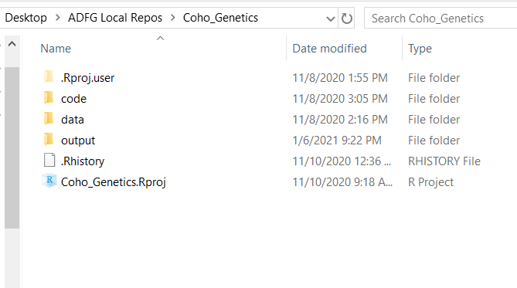
Directory Structure
It is very helpful to standardize your structure
Under your main project folder, use one .Rproj for that group of analyses. Use folders named:
data
code (or “analysis”)
output
etc.
Notes:
At ADF&G, we try to use a standardized folder structure so that everyone knows where everything is.
If you will ever share your code with anyone (including me!) it is super helpful to put everything you need inside the same folder, name folders with standardized names, and use an RProject

Slide 58
Packages
A package is just a collection of new functions (commands). If you’ve never used the package before, run: install.packages(“packagename”)
After this, you load it into R: library(packagename)
You’ll need to load your libraries every time you restart R, so add the libraries you’ll need for that specific script at the top.
Run once!
> install.packages(“dplyr”)
> library(dplyr)
Run every time you open R

Slide 59





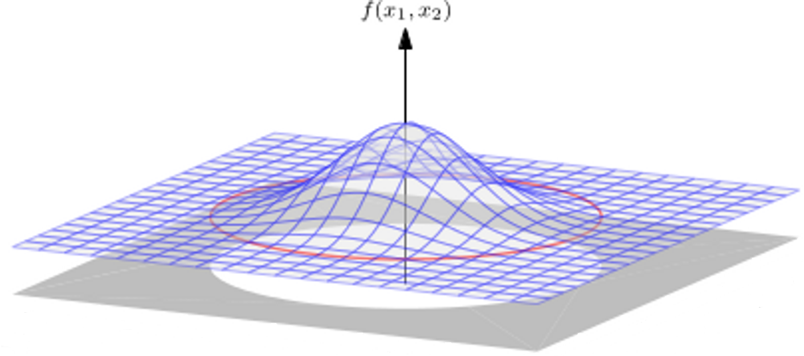


Packages cont.
Tidyverse contains several packages together for plotting, data cleanup, etc.
lubridate for dealing with dates
scales for dealing with ease of plotting axis scales
R
extrafont for pretty fonts
here for relative filenames (if you share / rename file directories),
extrafont
mgcv
mgcv or nlme for advanced modeling
vegan for multivariate statistics
cowplot or patchwork put multiple plots together
Notes:
Tidyverse – contains several packages together for plotting, data cleanup, etc. More on this later
1000s of others

Slide 60
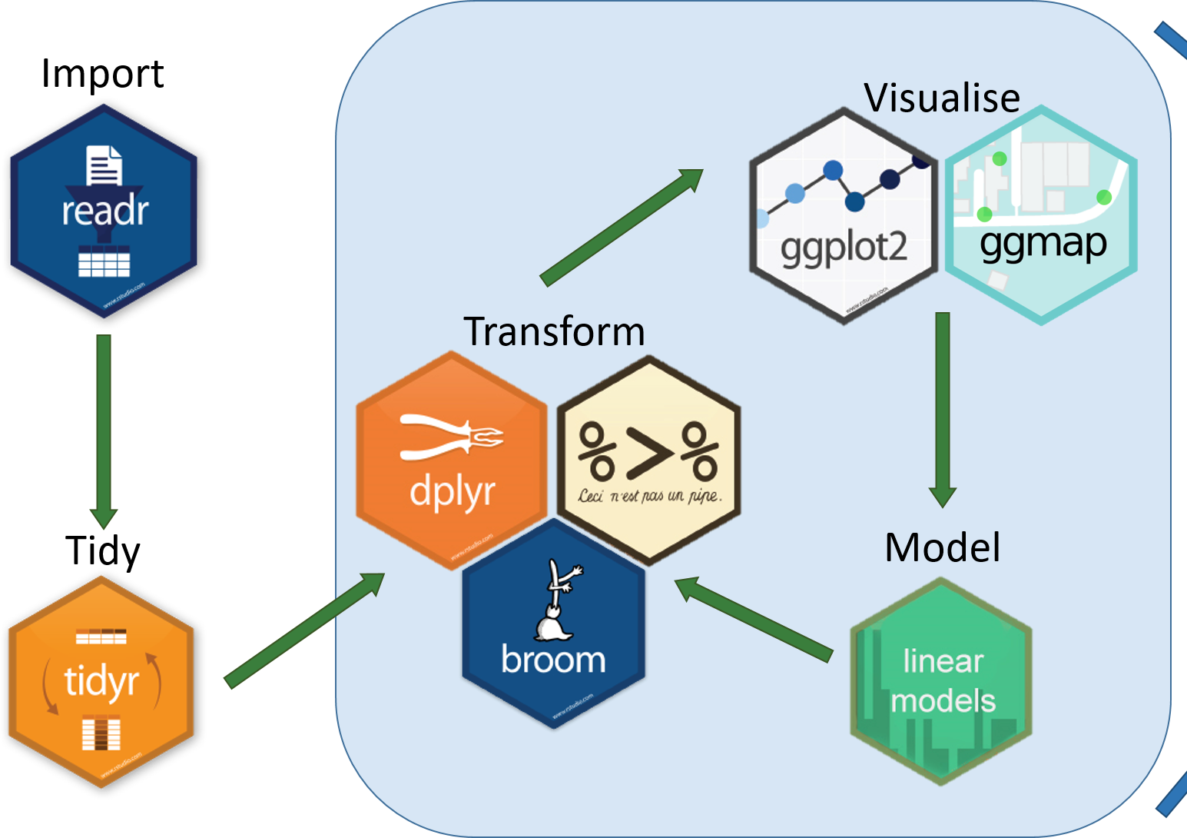

Common Analysis Workflow
Communicate

Slide 61
But Wait! There’s More!

Slide 62
Quiz 3-1
After running library(mgcv) you see “Error in library(mgcv) : there is no package called ‘mgcv’ ”. What should you do?
Install package via install.packages(“mgcv”)
Double-check spelling of package
Call for help
Curl into a ball and cry
After running read.csv("mydata.csv") you see “Error in file(file, "rt") : cannot open the connection
In addition: Warning message:
In file(file, "rt") : cannot open file 'mydata.csv': No such file or directory”. What should you do?
Check working directory (getwd())
Double-check spelling of file
Check if file is in a subfolder
Curl into a ball and cry
QUIZ!

Slide 63
Quiz 3-1 Answers
After running library(mgcv) you see “Error in library(mgcv) : there is no package called ‘mgcv’ ”. What should you do?
Install package via install.packages(“mgcv”)
Double-check spelling of package
Call for help
Curl into a ball and cry
After running read.csv("mydata.csv") you see “Error in file(file, "rt") : cannot open the connection
In addition: Warning message:
In file(file, "rt") : cannot open file 'mydata.csv': No such file or directory”. What should you do?
Check working directory (getwd())
Double-check spelling of file
Check if file is in a subfolder
Curl into a ball and cry
QUIZ!

Slide 64
Data Do’s & Data Don’ts
Don’t use summarized data (if possible)
To the extent possible, do cleanup in R so that if you re-download from OceanAK you don’t have to spend time changing things
Starting out, you can “cheat” and clean up in Excel first
It is highly recommended to bite the bullet and do all of this in R!
Don’t use “tabled” data, e.g., Year by Stream
Use “long” format with many rows where each row is a year and a stream
Use “tidy” data where:
- Every column is variable. - Every row is an observation. - Every cell is a single value.
More info here
Notes:
Before getting your data in, you will need to make sure that it is “machine readable”
Using R and the tidyverse will make you better with your data. While Excel is great for many things, especially quickness, it allows for bad habits. For example, it will let you combine different types of data into the same column (a column for “Length” can include 100, TRUE, “No sample here”; this is a massive data issue).

Slide 65
Tidy vs non-tidy data
Which of these datasets are tidy data?
Year | River | Count
2018 | Auke Creek | 619
2019 | Auke Creek | 1235
2020 | Auke Creek | 634
2018 | Berners River | 3550
2019 | Berners River | 9405
2020 | Berners River | 3296
2018 | Hugh Smith | 619
2019 | Hugh Smith | 1235
2020 | Hugh Smith | 634
Year | Auke Creek | Berners River | Hugh Smith Lake
2018 | 146 | 3550 | 619
2019 | 345 | 9405 | 1235
2020 | 173 | 3296 | 634
This one!
Any guesses why?

Slide 66
Tidy vs non-tidy data
To see why: if there were a comment, which does it refer to?
Year | River | Count | Comment
2018 | Auke Creek | 619 | No fish 7/24-8/25
2019 | Auke Creek | 1235 | Andy quit counting
2020 | Auke Creek | 634 | High water 8/30
2018 | Berners River | 3550
2019 | Berners River | 9405
2020 | Berners River | 3296 | Not a peak count
2018 | Hugh Smith | 619
2019 | Hugh Smith | 1235 | Prob 100 fish low
2020 | Hugh Smith | 634 | Andy didn’t count jacks
Year | Auke Creek | Berners River | Hugh Smith Lake | Comment
2018 | 146 | 3550 | 619 | No fish 7/24-8/25
2019 | 345 | 9405 | 1235 | Andy quit counting
2020 | 173 | 3296 | 634 | Prob 100 fish low
Notes:
Why isn’t this tidy? If the last column were for “comments”, which observation would the comment refer to?

Slide 67
Tidy Data
year | river | species | count
2007 | Kenai | burbot | 5
2007 | Susitna | burbot | 9
2007 | Susitna | sucker | 3
2008 | Kenai | burbot | 6
2008 | Susitna | burbot | 8
2008 | Susitna | sucker | 3
year | river | species | count
2007 | Kenai | burbot | 5
2007 | Susitna | burbot | 9
2007 | Susitna | sucker | 3
2008 | Kenai | burbot | 6
2008 | Susitna | burbot | 8
2008 | Susitna | sucker | 3
year | river | species | count
2007 | Kenai | burbot | 5
2007 | Susitna | burbot | 9
2007 | Susitna | sucker | 3
2008 | Kenai | burbot | 6
2008 | Susitna | burbot | 8
2008 | Susitna | sucker | 3
Each column is a variable
Each row is an observation
Each cell is a value

Slide 68

Why be Tidy?
Why does it matter to be tidy?
Though Excel worked quickly, it gave us all bad habits
By using tidy data, we can:
Add comments to each observation
Easily pair a variable to a data
Ensure all observations are of same type & structure
Who cares?!

Slide 69
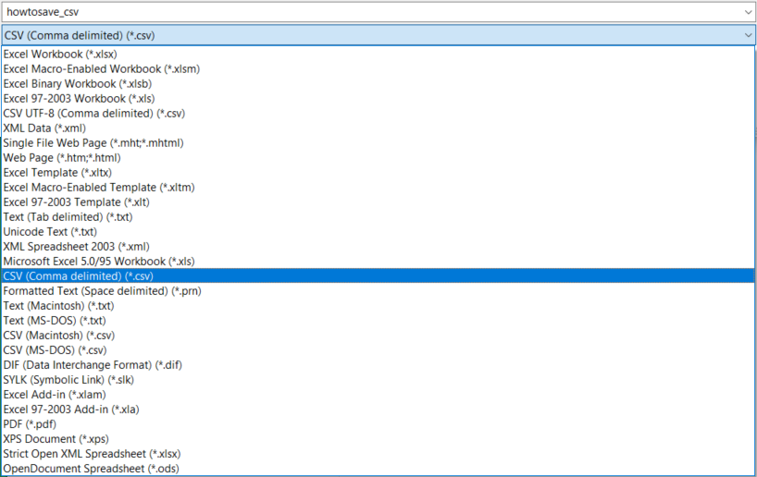
FINALLY! Getting data into R!
Import things as a .CSV if you can
This prevents issues by using a static file (i.e., no formulas)
(All databases allow export as .CSV)
You can still import files in .XLS or .XLSX but it’s easier to use “flat” files
Use “read.csv()” or “read_csv()”
We haven’t yet used the “tidyverse”, so we’ll only use read.csv(). In future, read_csv() is better
X

Slide 70
Reading in a file
Getting data into R is relatively simple! Use:
read.csv(“folderlocation/filename.csv”)
read.csv(“folderlocation\\filename.csv”)
NOT read.csv(“folderlocation\filename.csv”)
You must use a forward slash “/” or 2 back slashes “\\” to designate a folder or directory
This is different than the way Windows shows
Again, a better function will be read_csv()

Slide 71
SHOW ME THE DATA
OK so you have your data in. How can we look at it?
Type the name in console (shows first few rows/columns)
Type View(dataframe_name), or click on the dataframe name in the top right pane (same as View).
Once opened, you can now filter, sort, scroll, etc.
Check structure: str(dataframe_name)
summary(dataframe_name) to see info about dataframe

Slide 72


Data Import
Simply importing the data is the easy part
What takes time is being thorough, so your data is:
Clean, tidy data;
Clearly named
Correct column “type”
Excuse me,
do you have a moment to speak about programming?

Slide 73
Data Import
Analysis Checklist
Data is:
QA/QC’d
Flat file (.csv, etc.)
Not summarized
One row/observation
Make a new directory (folder) & RProject

Slide 74
Quiz 3-2
Which of these correctly reads a file “mydata.csv” from folder “data” into R?
readcsv(“data/mydata.csv”)
read.csv(“data/mydata.csv”)
read(“data/mydata.csv”)
read.csv(“data\mydata.csv”)
What is tidy data?
All columns are variables
One row, one observation
Tabled data
QUIZ!

Slide 75
Quiz 3-2 ANSWERS
Which of these correctly reads a file “mydata.csv” from folder “data” into R?
readcsv(“data/mydata.csv”)
read.csv(“data/mydata.csv”)
read(“data/mydata.csv”)
read.csv(“data\mydata.csv”)
What is tidy data?
All columns are variables
One row, one observation
“Tabled” data
QUIZ!

Slide 76
Let’s play with data
Motivating example 2

Slide 77
4 – Basic Data Manipulation
Mmm, the Good Stuff

Slide 78
What is data manipulation
Now that you’ve got your data into R, you’ll usually have to modify it in some way. For example:
Excluding certain years or species
Adding a new calculated column (CPUE)
Pooling groups together
Why do this in R?
You’ll always have a record of what you did to your data
Your script can repeat process (e.g., if you re-download data out of your database and need to rename data, add a calculated column, etc.)
The best package for this is “dplyr” (& other tidyverse packages)

Slide 79
Filtering: filter()
You’ll often need to exclude or subset a group of data
Use filter() to keep certain rows
You might want to exclude NAs
This is a little trickier because something can’t be equal to an unknown. Use is.na()
> filter(dataframename, Year == 2018, Species != “Pink salmon”)
> filter(dataframename, !is.na(Length))
> filter(dataframename, Year == 2018 | Year == 2019)
> filter(dataframename, Year == 2018 & Year == 2019)
This would return no rows. Why?
Year can’t be 2018 AND 2019
Notes:
Command filter() is from the dplyr library so you’ll need to load that first

Slide 80
Rename Columns: rename()
If columns come with spaces in them, R imports them to have backticks, e.g., `Column 1 Name`. Rename these to remove spaces
Depending on how you import, you’ll want to pay attention to the names
> rename(dataframename, “newcolumnname1” = “oldcolumnname1”, “newcolumnname2” = “oldcolumnname2”)
> rename(dataframename, “newcolumnname1” = `old column`)
Notes:
Command rename() is from the dplyr library so you’ll need to load that first

Slide 81
Add New Column: mutate()
You can add, divide, multiply columns by each other
Use an “if else” statement to make a conditional column
> mutate(dataframename, newcolumn = column1 + column2)
> mutate(dataframename, newcolumn = column1 / column2)
> mutate(dataframename, newcolumn = “Good data”)
> mutate(dataframename, newcolumn = ifelse(column1 > 1, “what to write if true", “otherwise write this"))
Notes:
From package dplyr

Slide 82
Only Keep Certain Columns: select()
List all columns to keep or add a negative to drop specific columns
Note that you can use select() to specify column order
(Using the double colon “::” specifies which package the function should come from)
> dplyr::select(dataframename, columnname1, columnname2, columnname3)
> dplyr::select(dataframename, columnname1, columnname2, columnname3)
> dplyr::select(dataframename,
-columnname1)
> dplyr::select(dataframename, columnname1:columnname4)
Note: There can occasionally be a conflict between dplyr’s select and another package. To ensure that you are using the right select, use dplyr::select(). This is a very rare issue however.
Notes:
In all the thousands of lines of code I’ve written, I only had the select conflict once.
The double semi colon is helpful in the very rare event that two packages have the same exact named function. How would R know which one to choose?

Slide 83
The “pipe”
dplyr also brings use the functionality of a “pipe”, written as %>%
The pipe operator allows us to string together several functions and pass each of them to the next one
> dataframename <- filter(dataframename, Year == 2018)
> dataframename <- mutate(dataframename, surveymonth = month(surveydate))
> dataframename <- select(dataframename, Year, surveymonth, totalcount)
> dataframename <- dataframename %>% filter(Year == 2018) %>%
mutate(surveymonth = month(surveydate)) %>%
select(Year, surveymonth, totalcount)

Slide 84

%>% advantages
The pipe passes the object from the left to the right. Most often this passes a dataframe as an argument from the left to the right.
Stringing together many lines of code at once is:
more readable,
doesn’t repeat the same variables over and over,
helps prevent “out of order” code problems,
reduces excessive nesting of functions within functions

Slide 85
Replace a value: recode()
You may often want to replace a value in the dataframe.
E.g., In column “Species” you want to change “coho” to “Coho Salmon”
recode() is for replacing a value
replace_na() replaces all NAs in a column. (From package “tidyr”)
Be aware of the potential issue with replacing all NAs!
dataframename %>% mutate(Species = recode(Species, “coho” = “Coho Salmon”))
dataframename %>% mutate(columnname = recode(columnname, “oldvalue” = “new and improved value”))
dataframename %>% mutate(columnname = replace_na(columnname, “what you want it replaced with”))
Notes:
Now that we’ve learned about the pipe, we can use it
Only put the replaced parts in quotes if you are replacing a character

Slide 86
Quiz 4
Filter a dataframe named “df” to remove NAs from column “leng”
filter(df, leng, na.rm=TRUE)
filter(df, leng, !NA)
filter(df, !is.na(leng))
filter(df$leng, is.na)
df %>% filter(!is.na(leng))
Can test your answers in R using other existing dataframes
From dataframe “df”, calculate a new column of CPUE from columns “catch” and “effort”
mutate(df, CPUE = catch / effort)
newcolumn(df %>% CPUE = catch / effort)
df$CPUE <- mutate(df$catch / effort)
df$CPUE <- Mutate(df, CPUE = catch / effort)
QUIZ!

Slide 87
Quiz 4 ANSWERS
Filter a dataframe named “df” to remove NAs from column “leng”
filter(df, leng, na.rm=TRUE)
filter(df, leng, !NA)
filter(df, !is.na(leng))
filter(df$leng, is.na)
df %>% filter(!is.na(leng))
From dataframe “df”, calculate a new column of CPUE from columns “catch” and “effort”
mutate(df, CPUE = catch / effort)
newcolumn(df %>% CPUE = catch / effort)
df$CPUE <- mutate(df$catch / effort)
df$CPUE <- Mutate(df, CPUE = catch / effort)
QUIZ!
Why didn’t these run?
Only “is.na()” can find NAs
Why didn’t these run?
Incorrect use of $, wrong mix/match of pipe, capitalization

Slide 88
Review & Day 1 Break
OH THANK GOODNESS

Slide 89
Review – About R
RStudio 4 panes: Script editor, console, environment, plot/help
Use <- or = to set (“save”) a variable
Code must end on comma or similar
A “function” is (usually) made up of argument(s)
Variables (dataframe) are set to access later
str(), $, [], c()

Slide 90
Review – Basics
Errors
NAs
mean(), sum(), log()
Make sure to use quotes when you describe a character
Use descriptive variable names
& means “AND”, | means “OR”
A dataframe is group of columns and rows

Slide 91
Review – Working with your data
Directories – Make sure that you are in the correct directory
An RProject makes this very simple
Packages – Add more functions for us to use
Load them for use by using library()
Tidy data – One row per observation, not summarized
Check that structure of data matches what it should be
Use str(), especially checking for character vs factor or numerical vs character

Slide 92
Review – Data manipulation
The basic commands to modify your data are:
select() Keep or remove columns
filter() Keep rows that meet your conditions
rename() Change column names
mutate() Make new columns
recode() Replace values
The pipe, %>%, makes your code cleaner and shorter

Slide 93
Review – Tomorrow
If today was difficult, that’s expected! Pat yourself on the back, we’ve covered a LOT of material.
Remember our goals. By the end of tomorrow you will be able to:
Import your OWN data into R
Perform basic analyses
Make publication worthy figures
If you didn’t finish a learnr section, revisit it over next few days
Look at the dataset to bring to Friday’s class. Is it tidy? Is it tabled?
If you have questions or are confused about anything, PLEASE email me sometime this week

